Slide 1

Vehicle Routing at a Regional Discount Company
BA 578 – Supply Chain Analytics
- Data Analytics 2 -
Group 3
// Eunjeong Heo
// Kwong Wa Lam
// Korbin Sorensen
// Tina Tangkittiwet
// Ryan Liu
// Tianhong Zhang
// Florian Houguet

Slide 2
Topics
1) Team Intro
2) Case Intro 3) First Cost Reduction Strategy 4) Second Cost Reduction Strategy 5) Final Recommendation

Slide 3






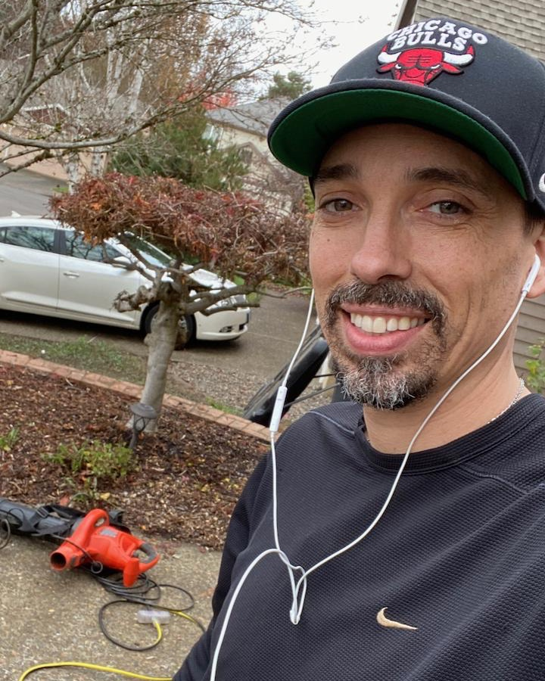
EunJeong Heo
The Team
01.
02.
03.
04.
Photos
Kwong Wa Lam
Korbin Sorensen
Tina Tangkittiwet
Track: SC Analytics MSB
From: South Korea
Track: SC & Logistics MBA
From: Hong Kong, China
Track: SC Analytics MSB
From: Washington State
Track: SC Analytics MSB
From: Thailand
05.
06.
07.
Ryan Liu
Tianhong Zhang
Florian Houguet
Track: SC Analytics MSB From: Taiwan
Track: SC Analytics MSB
From: China
Track: SC & Logistics MBA
From: France

Slide 4
CASE INTRO
(Tianhong)

Slide 5


Case Intro
SYNOPSIS
GOALS
This case focuses on the vehicle routing decision for a regional discount store chain based in Oregon. The company has one distribution center in Albany, OR that delivers shipments each day to 15 stores in Oregon and southwest Washington.
The distribution center in Albany, OR receives full truck-load shipments from all suppliers and builds mixed pallets of products to fulfill orders from the individual stores. Although the orders vary each day, the overall volume of each order remains relatively constant.
Your team must investigate possible cost reduction measures in order to maximize the weekly profit.

Slide 6


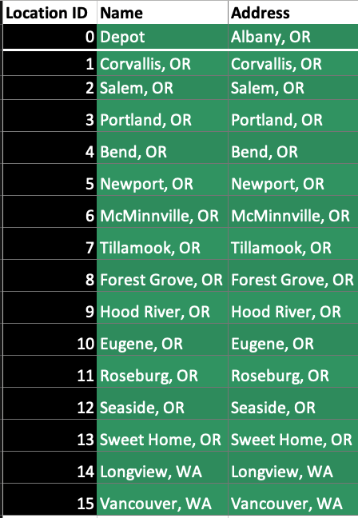
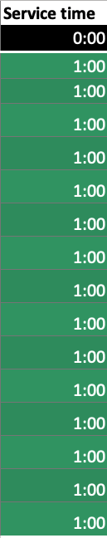
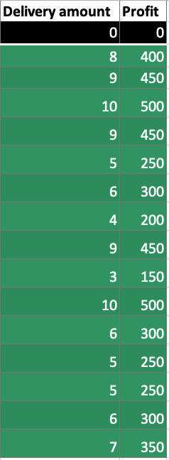
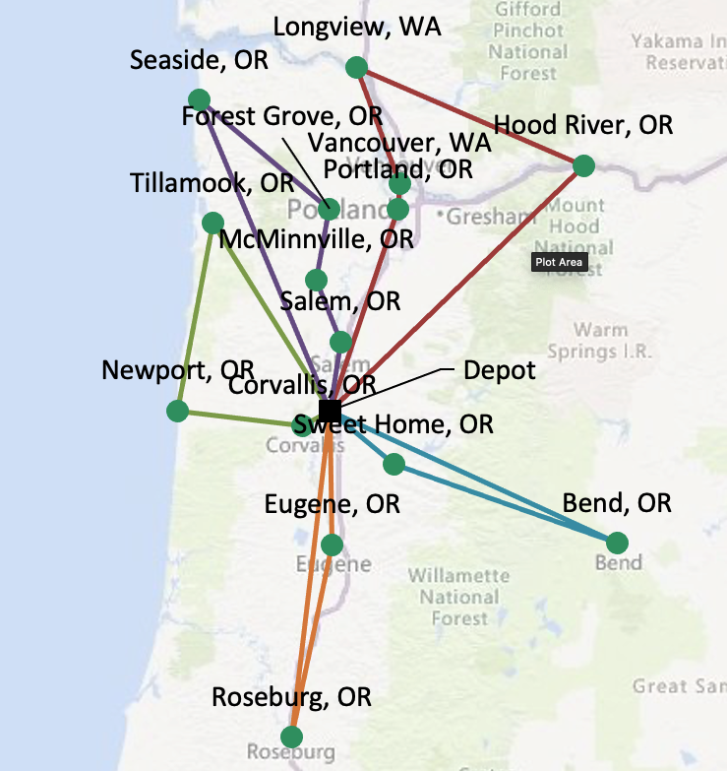
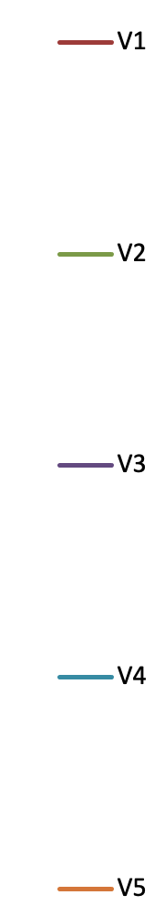
Routes Calculation
LOCATIONS
VRP SOLVER
BEST ROUTES

Slide 7
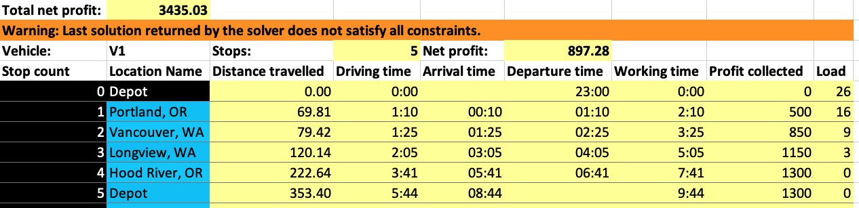
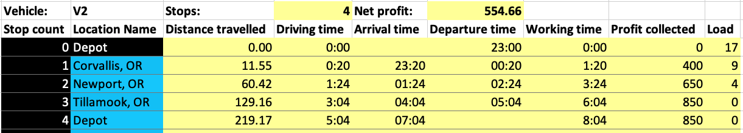
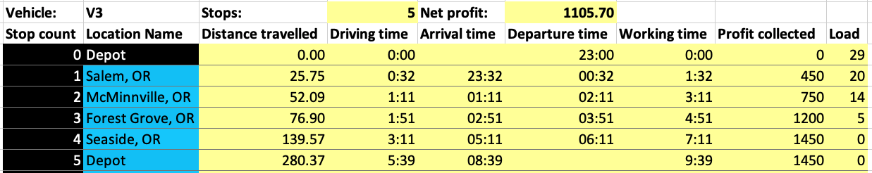
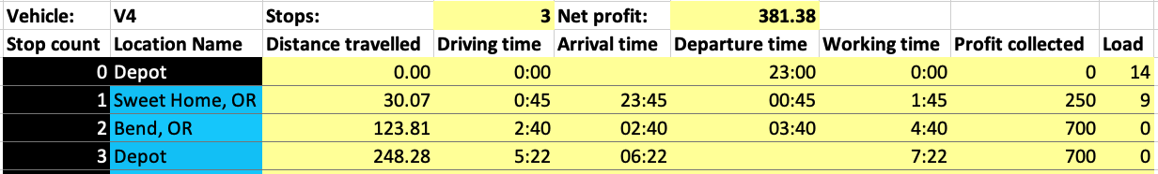
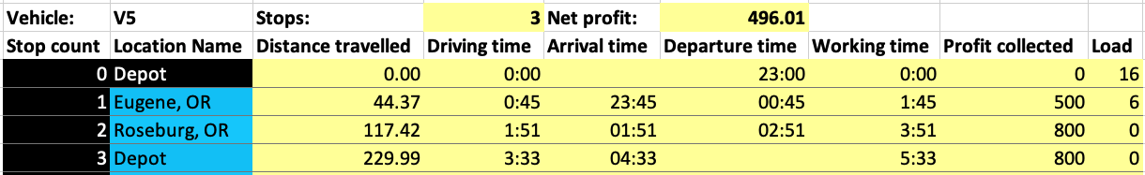
Daily Profit

Slide 8
First Cost Reduction
(Korbin/Kwong)

Slide 9


First Cost Reduction Proposal
SUMMARY – Model 1
Pros
Cons
One great cost reduction strategy is to lower the number of trucks & have the trucks run all day to fulfill all the deliveries. When we have 2 trucks run all day with a mid-day stop at the depot we get total daily profit of $3880.
Daily profit will be up $445 a day or 13% profit increased.
2 trucks only make for a great utilization of the truck’s capacity which is a good thing for a business.
High-risk for 1 truck to be out-of-service regularly throughout the year. Keeping a backup truck available.

Slide 10
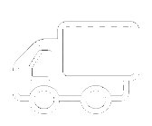
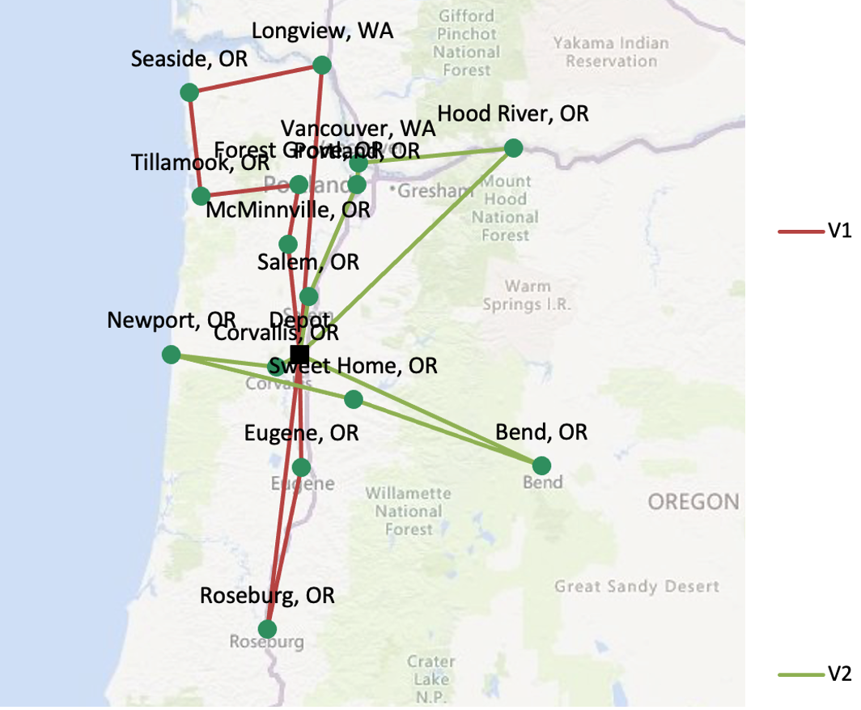
Routes Calculation
VEHICLES UPGRADE
VRP SOLVER
BEST ROUTES

Slide 11
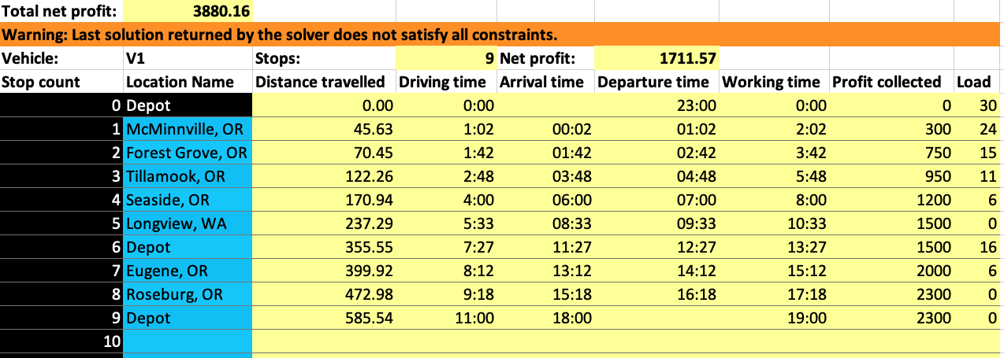
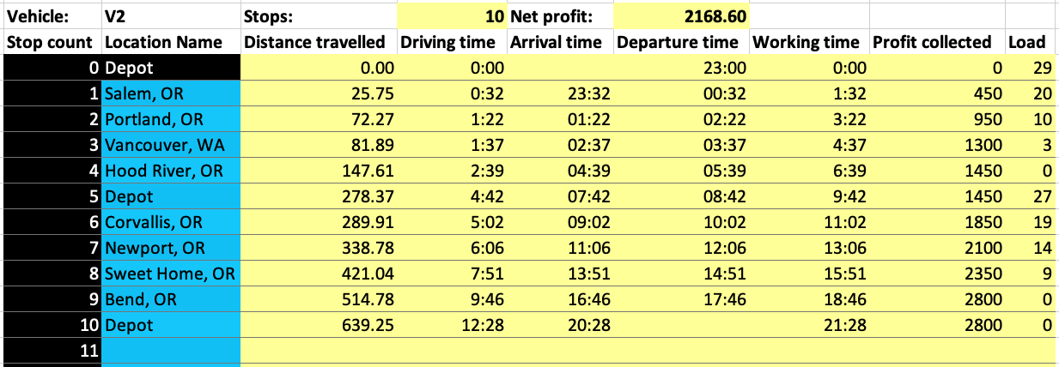
Daily Profit

Slide 12
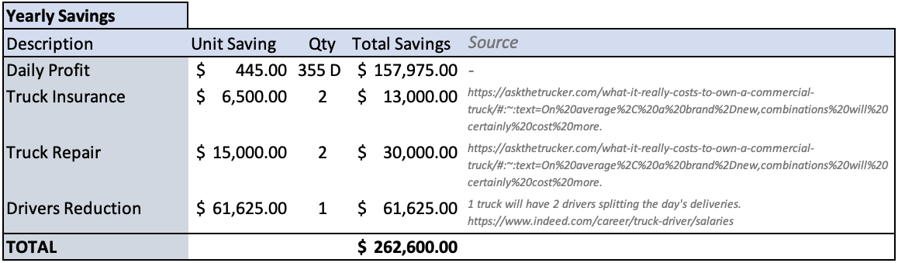
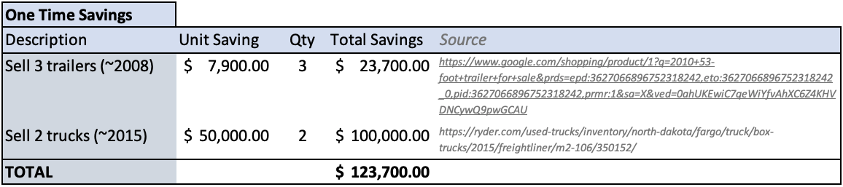
Other Financial Savings

Slide 13
Second Cost Reduction
(Tina/Eunjeong)

Slide 14
Second Cost Reduction Proposal
Pros
16 % of
Profit
Growth
SUMMARY – Model 2
Cons
Lower the number of trucks and open another warehouse closer to the Portland area as well as to reduce our customers service time from 1 hour to 45 minutes. When opening a new warehouse in McMinnville, the daily profit of such model grows to $3966.64.
2 trucks = great utilization of the truck’s capacity.
2 warehouses = more responsive value chain to customers.
Warehouse expansion = revenue growth
Efficient and flexible labor scheduling of employees.
High-risk for 1 truck to be out-of-service
Keeping a backup truck
2 warehouses will dilute the inventory to serve the customers
Investing in an Inventory
Management System
• Faster service time will require
more efficiency in our processes
Leverage our new IT system to
be more digital (advanced
shipment notice, barcode, RFID)
Notes:
Here, we lower the number of running trucks from 5 to 2 and open another warehouse closer to the Portland area. Also, we believe our customers service time can be reduced from 1 hour to 45 minutes. When opening a new warehouse in cheap area in McMinnville, OR the daily profit of such model grows to $3966.64. Which shows 16% of daily profit growth from the original vehicle routing plan.
By implementing this plan, the company can a make great utilization of the truck capacity. Having 2 warehouses means that the business is leaning toward a more responsive value chain to customers and having a potential business expansion.
However, in case one of the truck to be out of service, the business should keep a back-up truck available. And, preventing 2 warehouses will dilute the inventory, we will introduce an inventory management system. Last but not least, to keep up with stable 45 mins Customer service time, we will leverage our new Information Technology system to be more digital and accurate.

Slide 15
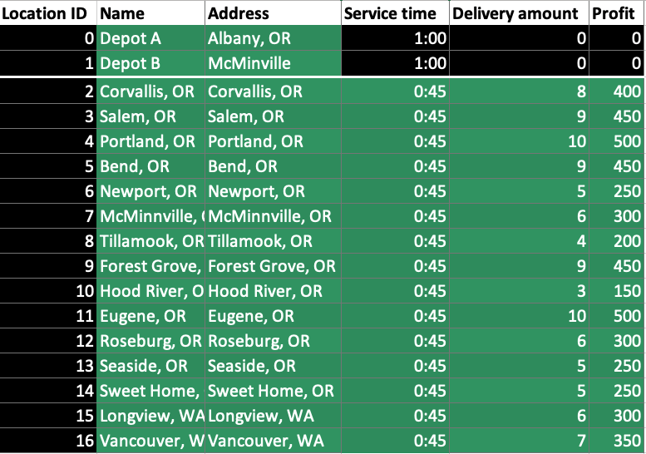
Routes Calculation
LOCATIONS
VEHICLES UPGRADE

Slide 16
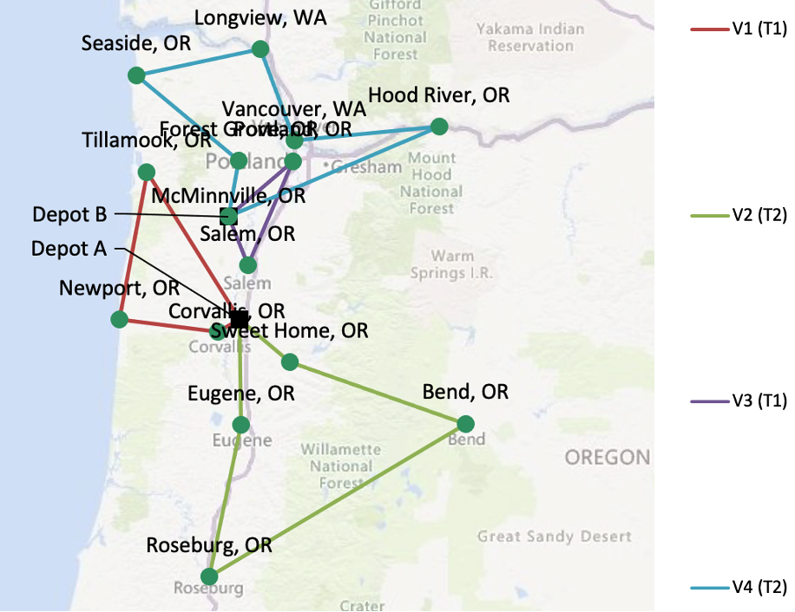
Routes Calculation

Slide 17
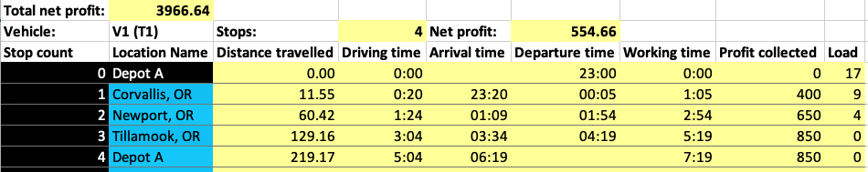
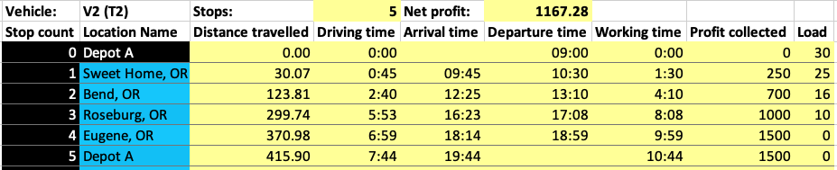
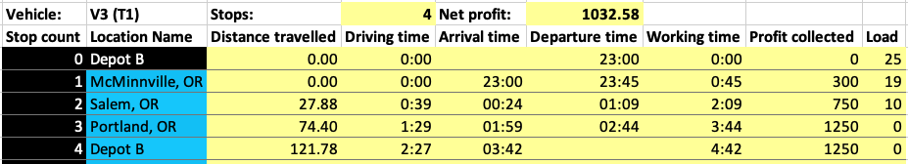
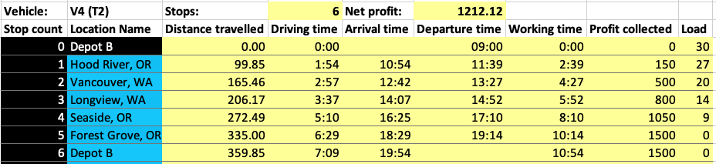
Daily Profit

Slide 18
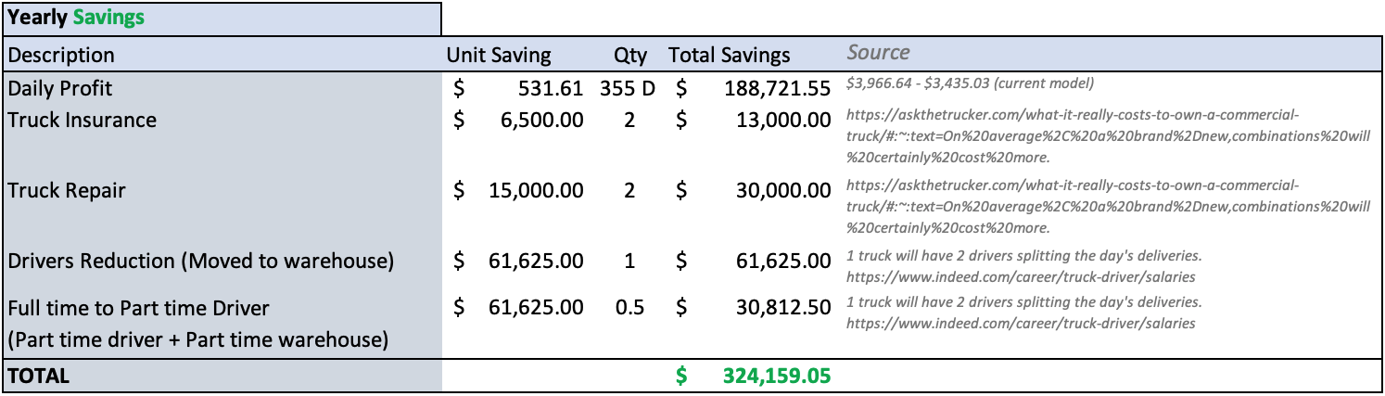
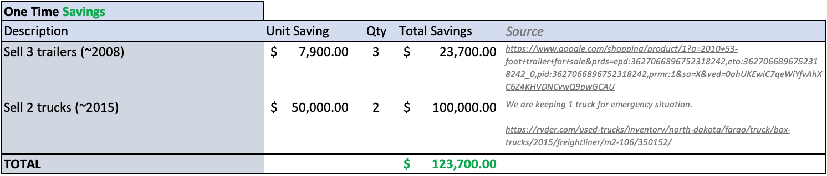
Other Financial Savings

Slide 19
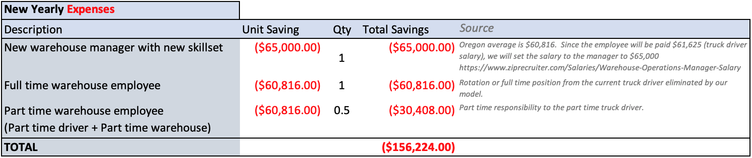
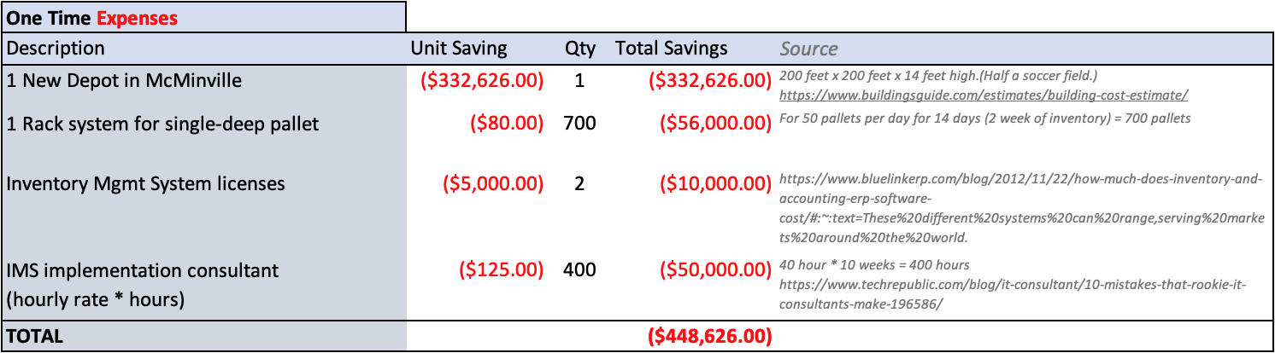
Other Financial Expenses

Slide 20
Final Recommendation
(Ryan/Flo)

Slide 21
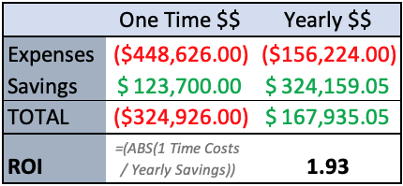
ROI
Return On Investment (or ROI)
In measure used to evaluate the efficiency or profitability of an investment by dividing the savings by the cost (expenses) of the investment.
FIRST COST REDUCTION MODEL
In this model, there wasn’t much investment needed apart from time of an employee to setup the new routes and dispose of the trucks and trailers. The ROI is therefore equals to 0. It is a very worthy model to consider.
SECOND COST REDUCTION MODEL
The initial cost equal $326K while generating a $167K yearly savings. The rough ROI calculation is therefore 1.93. It will take 1.93 years to get the initial cost investment back from the savings.

Slide 22
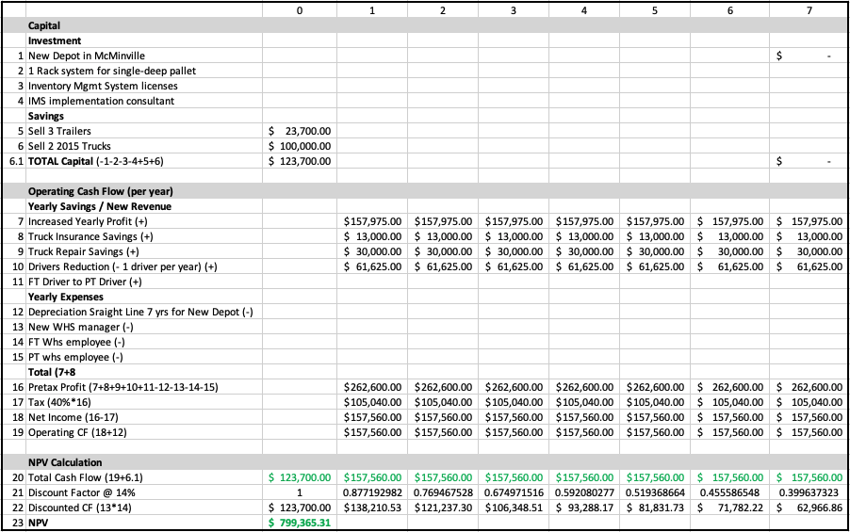
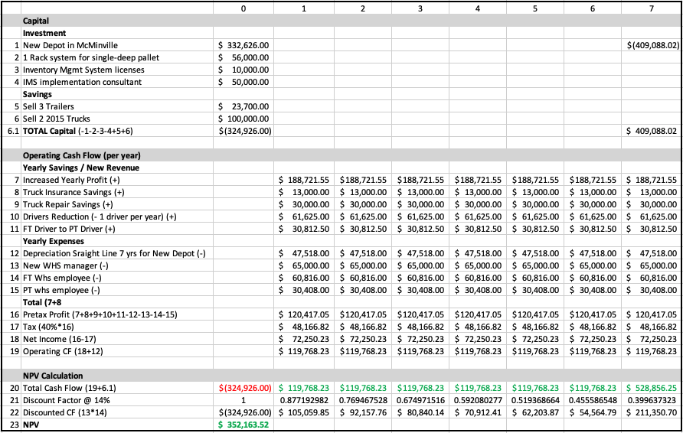
NPV
7-years NPV – First Model
7-years NPV – Second Model
NPV = $799,365
NPV = $352,164

Slide 23

NPV
Generate Yearly Revenue Growth of 25.10%
7-years NPV – First Model
7-years NPV – Second Model
NPV = $799,365
NPV = $801,336

Slide 24
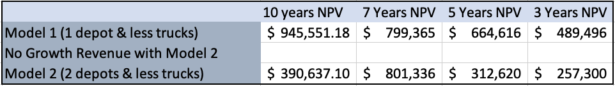
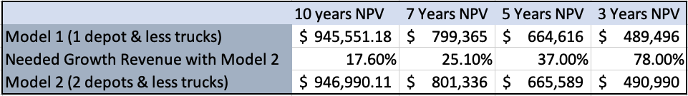
FINAL WORDS
While the Return on Investment is really good for the investment in Model 2, the management team will need to launch a market analysis to identify whether the introduction of a new depot truly enable the company to new revenue growth which cannot be reached from the Albany warehouse.
Based on 7 years NPV analysis, the yearly revenue growth will need to be 17.6% so that the NPV of Model 2 is better than Model 1. It seems like a huge growth that will need to be sustain for a long time. We should also look into a smaller warehouse and less safety stock to be levers to consider for our Model 2 to be more interesting financially.
We recommend for the business to NOT invest in a new warehouse at the moment and to execute our proposal from model 1.
Model 1: The cost reduction strategy is to lower the number of trucks & have the trucks run all day to fulfill all the deliveries. When we have 2 trucks run all day with a mid-day stop at the depot we get total daily profit of $3880.

Slide 25
Thank You
Group 3
// Eunjeong Heo
// Kwong Wa Lam
// Korbin Sorensen
// Tina Tangkittiwet
// Ryan Liu
// Tianhong Zhang
// Florian Houguet

